Slide 1


PUBLIC TRANSPORTATION OPTIMIZATION
Phase - 1

Slide 2
CONTENTS
Problem definition
Design thinking

Slide 3
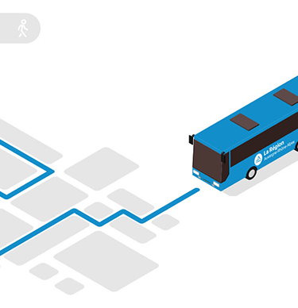
CONTENTS
1. INTRODUCTION
2. PROBLEMS
3. RECTIFICATION
4. CONCLUTION

Slide 4
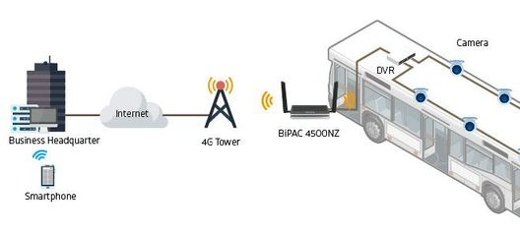
Abstract
Route optimization is the process of determining the most cost-effective and efficient routes for a vehicle or fleet of vehicles to take, while taking into account a number of restrictions such time frames, vehicle capacity, and road conditions

Slide 5
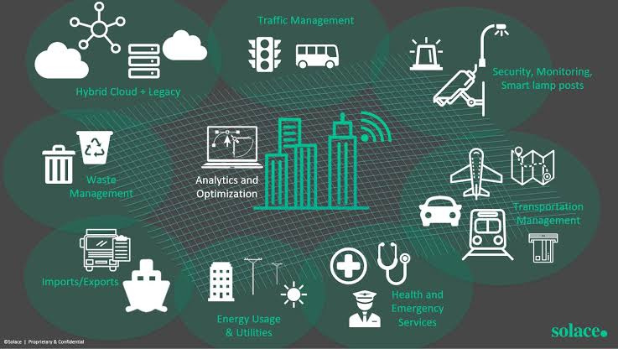
public Transportation
optimization

Slide 6

public transportation
optimization
public transportation optimization is a dynamic and multifaceted field that evolves to address the complex challenges of urbanization, environmental concerns, and the changing needs of communities. Its ultimate goal is to provide efficient, accessible, and sustainable transit services that benefit both passengers and the broader community.

Slide 7
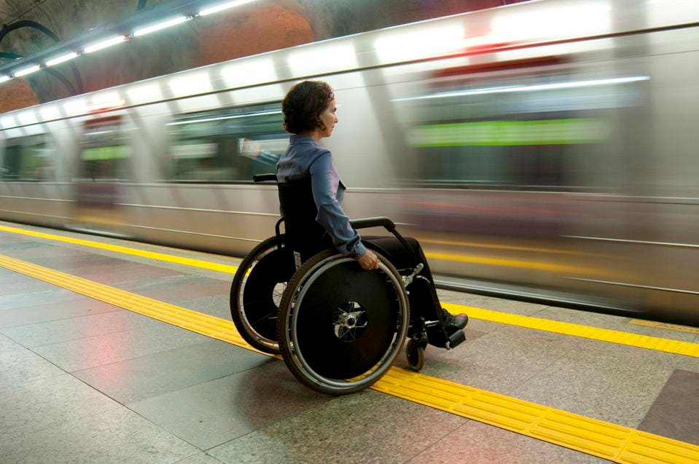
problem
Ensuring that public transportation is accessible to all, including individuals with disabilities, is essential. Optimization can help design routes and schedules that accommodate various accessibility needs, such as wheelchair access and visual/audio cues.

Slide 8
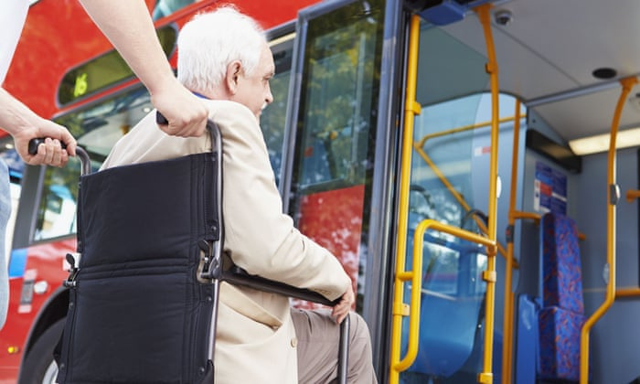
Rectification
Optimization can help design routes and schedules that accommodate various accessibility needs, such as wheelchair access and visual/audio cues.
Accessibility for persons with disabilities extends beyond physical or mobility impairments. Persons with visual or hearing impairments may also face challenges when using public transportation, such as difficulty reading small signage or hearing announcements.

Slide 9

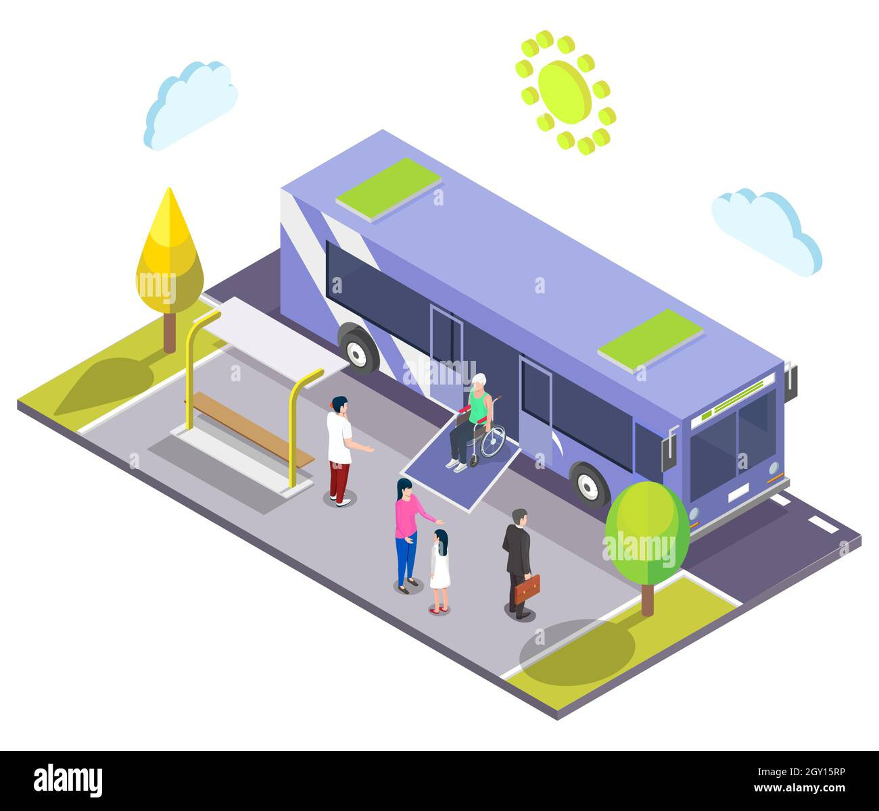

Slide 10
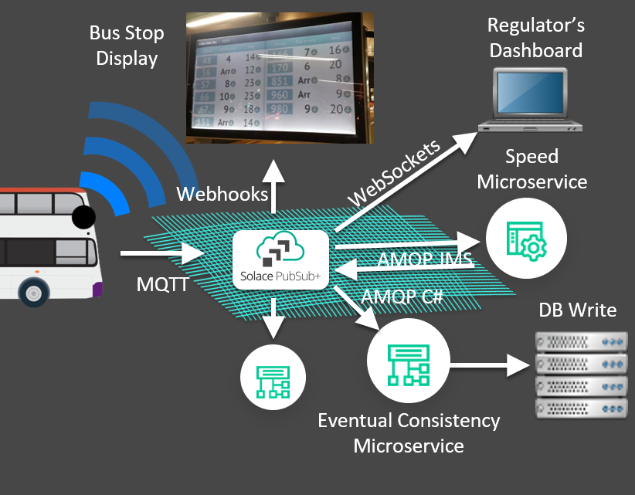
Ensuring that public transportation is accessible to all, including individuals with disabilities, involves designing infrastructure and vehicles with universal design principles and compliance with accessibility standards.

Slide 11
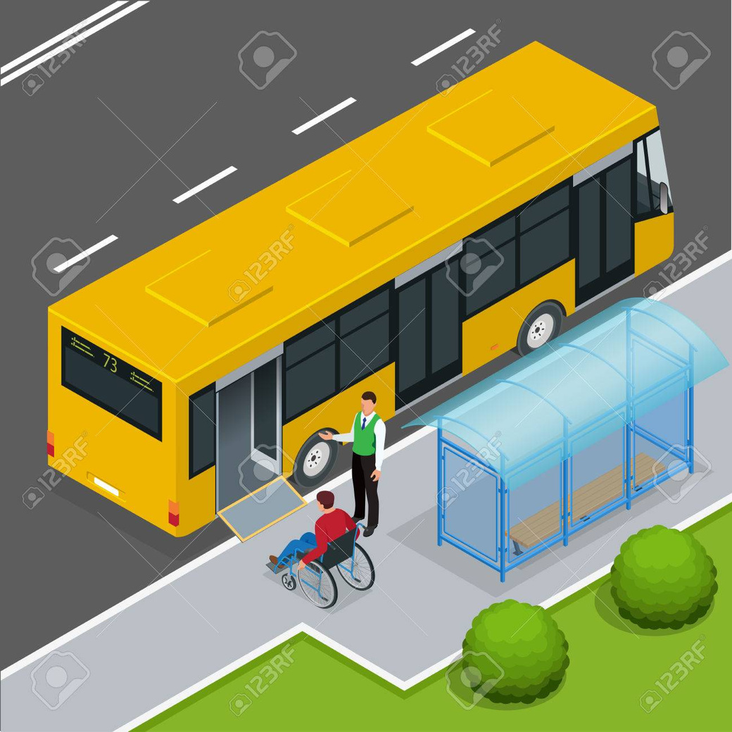
Thank you
"EFFICIENCY ON THE MOVE: TRANSFORMING TOMORROW'S TRANSIT"

